Slide 1

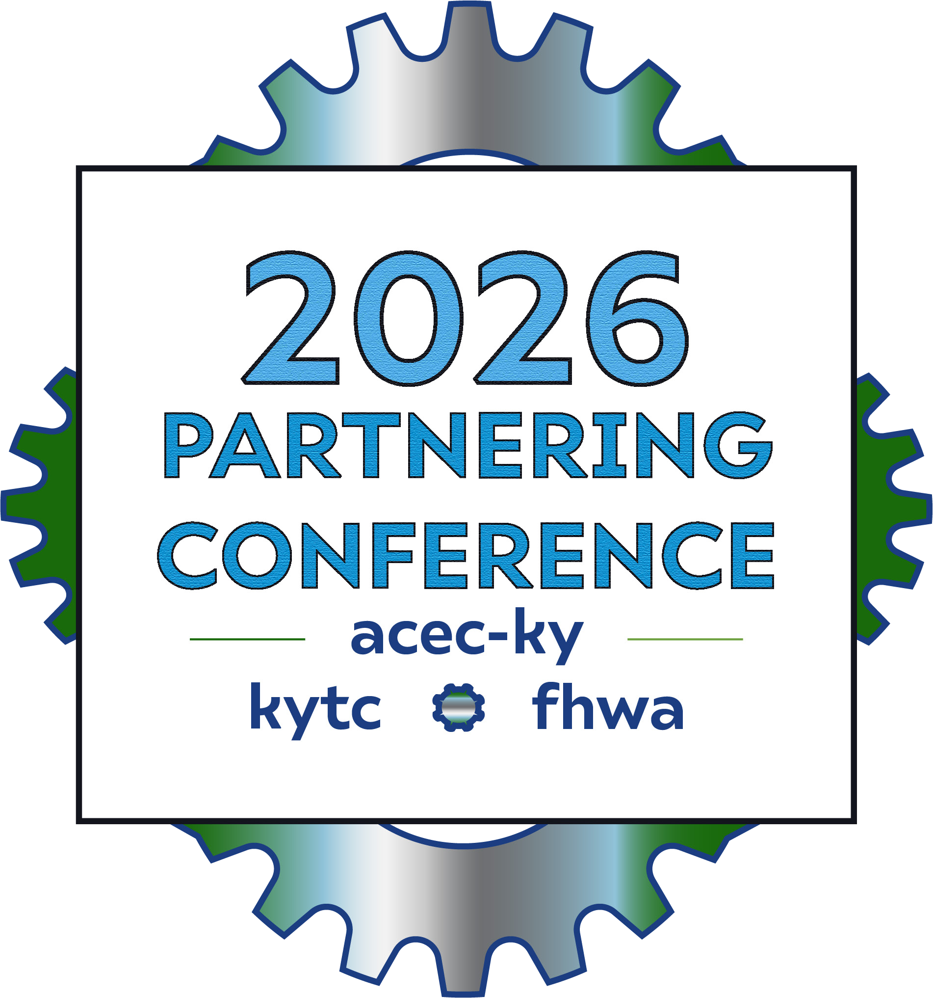
Full Speed Ahead
US 421 Progressive Design Build in Harlan County

Slide 2

VIDEO FLY THROUGH
(Before)

Slide 3



“Sailing on an Unfinished boat”
Notes:
May 2023 Driving 2026

Slide 4


“What and Why”
“is and do”
Progressive Design Build”

Slide 5

Alternative Contracting Method (ACM)
A hybrid project delivery method that combines the early contractor involvement benefits of Construction Manager/General Contractor (CM/GC) with the single-contract responsibility of Design-Build.
The design-builder is selected early in the process.
Design development progresses collaboratively among project stakeholders.
The final project price is negotiated after the scope becomes sufficiently defined.
Progressive Design-Build (PDB)
An alternative delivery method used when the project scope is not clearly defined at the outset.
Well-suited for projects with unique challenges or complex issues that must be addressed.
Brings all key parties together from the first day, including:
The owner
The project development team
The contractor
Encourages collaboration to develop practical and fundable project solutions.
Helps minimize project risks through early stakeholder involvement.
Provides greater cost certainty as the project scope and design evolve.

Slide 6
“The Project”
Notes:
The US 421 Reconstruction Project in Harlan County, Kentucky reconstructed approximately 1.347 miles of US 421 from the Harlan-Virginia state line corridor. The project affected 23 parcels consisting of rural residential properties, vacant residential tracts, and wooded hillside acreage. Of the 23 parcels, 11 were total acquisitions and 12 were partial acquisitions, with 16 parcels classified as major appraisal assignments due to their complexity. Key right of way challenges included landlocked remainders, potential proximity damages, and functional obsolescence impacts associated with the roadway improvements. The project also required the relocation of a cemetery and grave sites.

Slide 7
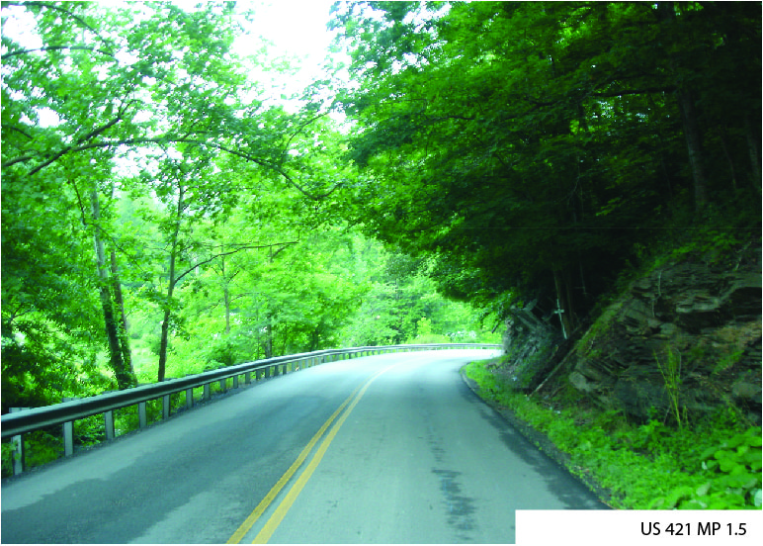

Slide 8
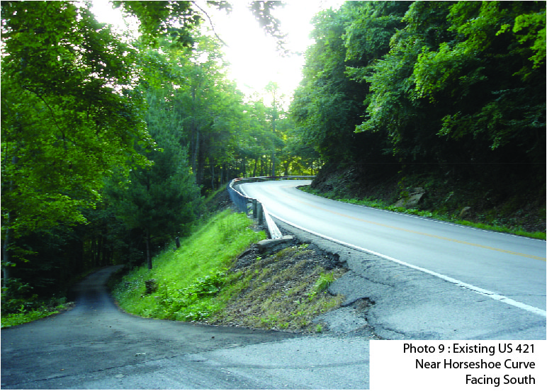

Slide 9
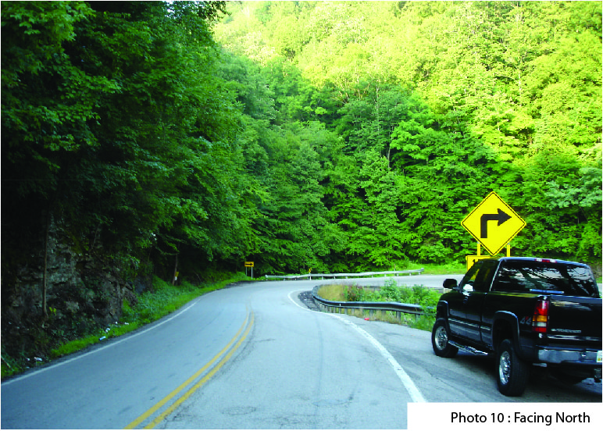

Slide 10
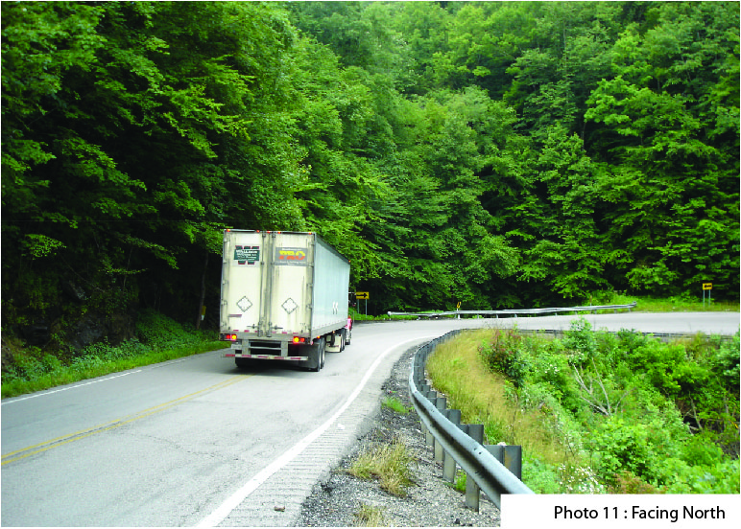
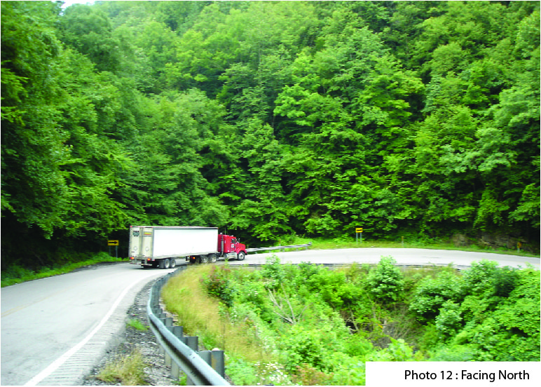

Slide 11
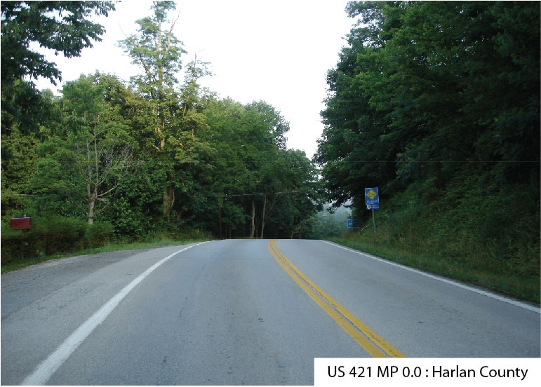

Slide 12
Notes:
The existing corridor from the Virginia state line to Milepoint 1.54 was narrow, lacked passing opportunities, and included sharp curves with design speeds below 25 mph and grades exceeding 10%, despite a posted speed limit of 55 mph. These conditions created significant safety and operational challenges.

Slide 13
“Acquisition”

Slide 14
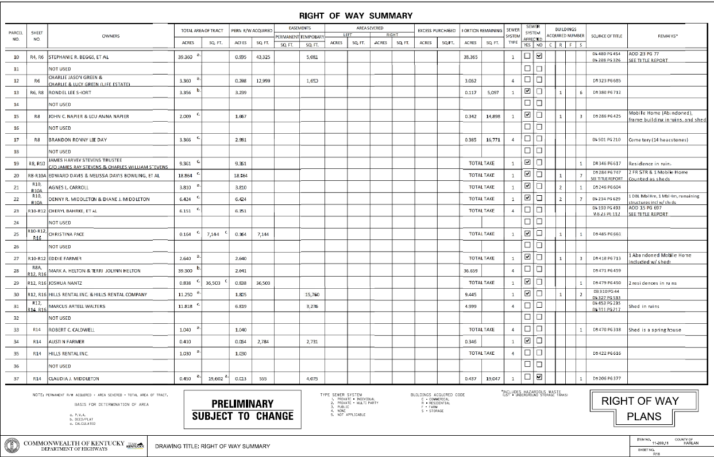
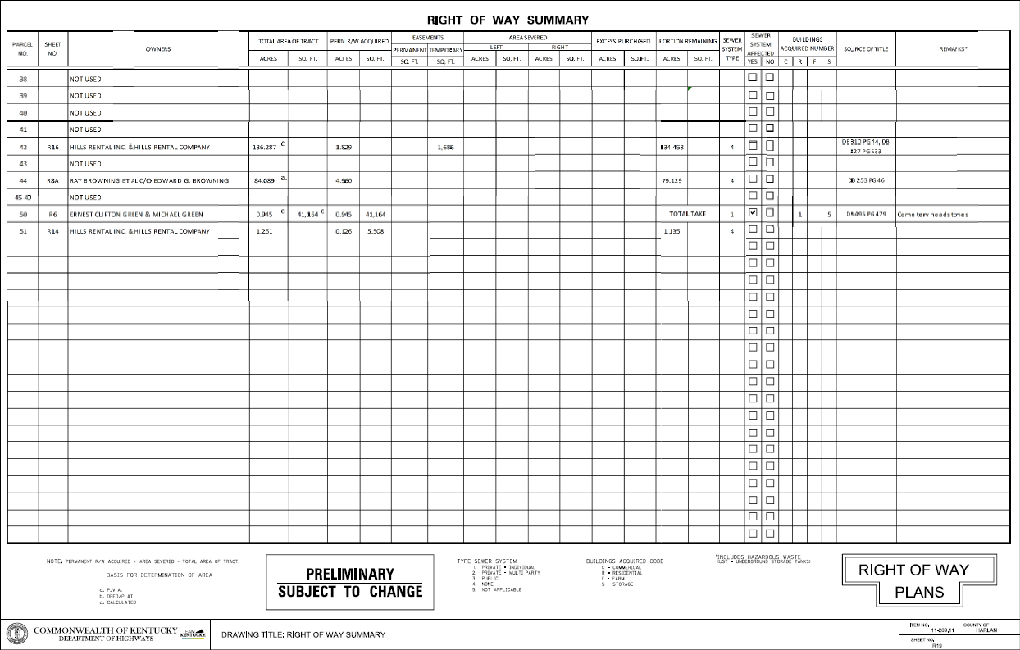

Slide 15
Complex Ownership Structure: The project involved numerous layered ownership interests that had developed over many years, making it difficult to clearly identify all parties with a legal interest in the affected properties.
Informal "Gentlemen's Agreements": Many property owners operated under long-standing informal arrangements rather than documented agreements, creating challenges in determining property rights, occupancy, and use.
Land Contract Purchasers: Several properties involved occupants purchasing property through land contracts, requiring additional research and coordination to establish interests and ensure proper acquisition procedures.
Non-Traditional Tenancies: The project included tenants occupying properties for little or no rent, often under informal agreements, requiring careful evaluation of occupancy status and potential relocation considerations.
Long-Standing Encroachment: The project required addressing a long-standing encroachment associated with the well-known local attraction, Butcher Holler Spook House, a unique situation that demanded careful coordination and stakeholder engagement.

Slide 16
75+ac Fee Simple ROW
27K SF
Temporary Easement
Acquired

Slide 17
“Relocation”
Notes:
Project Right of Way Impacts
11 total acquisitions and 13 partial acquisitions
10 residential relocations
8 owner-occupied residences
2 tenant-occupied residences
12 miscellaneous moves
10 associated with residential relocations
2 involving personal property within proposed ROW
3 separate locations of interred remains (Get total from Amy)

Slide 18
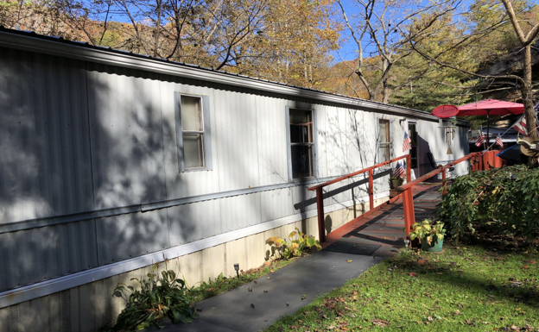
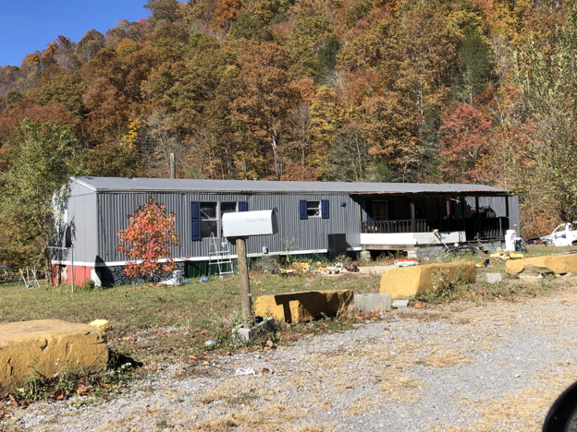
Complex Ownership and Occupancy Situations: Several residential properties involved joint ownership, where one or more owners did not occupy the dwelling. These situations created unique relocation challenges because the occupants eligible for relocation benefits often did not receive the full acquisition payment for the property.
Repeated Application of Complex Relocation Rules: The project team encountered this ownership and occupancy issue on several parcels, requiring repeated evaluations and individualized relocation planning rather than a standard one-size-fits-all approach.
Diverse Residential Property Types: The residential properties acquired varied considerably in age, condition, size, and market appeal. As a result, identifying suitable replacement housing required a tailored strategy for nearly every displaced household.

Slide 19
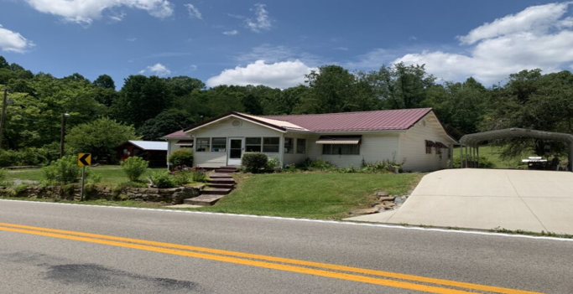
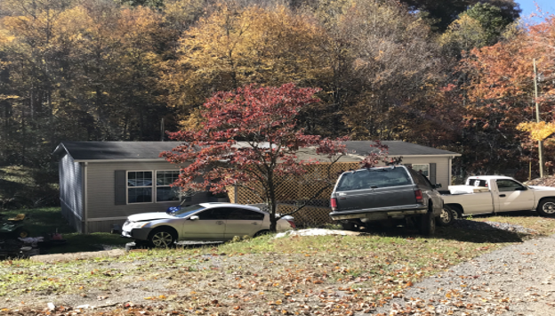
Proactive Housing Research: The relocation team conducted extensive research to identify potential replacement housing opportunities and worked closely with local real estate professionals to maintain current knowledge of available inventory.
Limited Availability of Comparable Housing: Finding comparable replacement dwellings within the local market was challenging due to the limited housing inventory and the unique characteristics of many of the acquired homes.

Slide 20
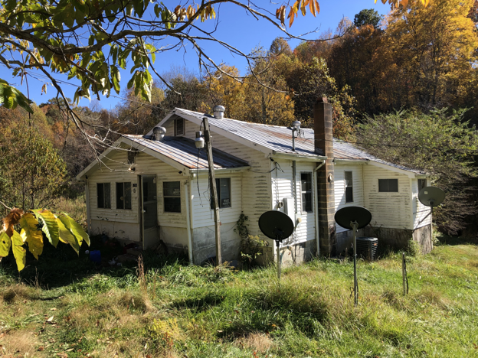
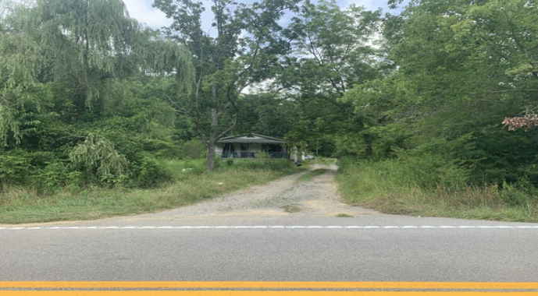
Individualized Relocation Assistance: Because every displacement presented unique circumstances, relocation services were customized to each occupant's situation, ensuring compliance with relocation requirements while addressing the practical realities faced by each household.
Strong Relationships with Property Owners: Through interior inspections and consistent communication with displaced residents, the team developed a thorough understanding of each household's needs, preferences, and circumstances, allowing for more effective relocation planning.

Slide 21
Successful Navigation of Sensitive Circumstances: Relocation inherently involves significant life changes for affected residents. The team's ability to navigate complex ownership structures, benefit calculations, limited housing availability, and individual household needs was critical to the successful completion of the project.
Commitment to Fair and Equitable Treatment: Throughout the process, the team remained focused on ensuring displaced occupants were fully informed of their rights, eligibility, and available housing options while maintaining a compassionate and professional approach.

Slide 22
“Grave Relocation”

Slide 23
Over 20 Graves were relocated

Slide 24
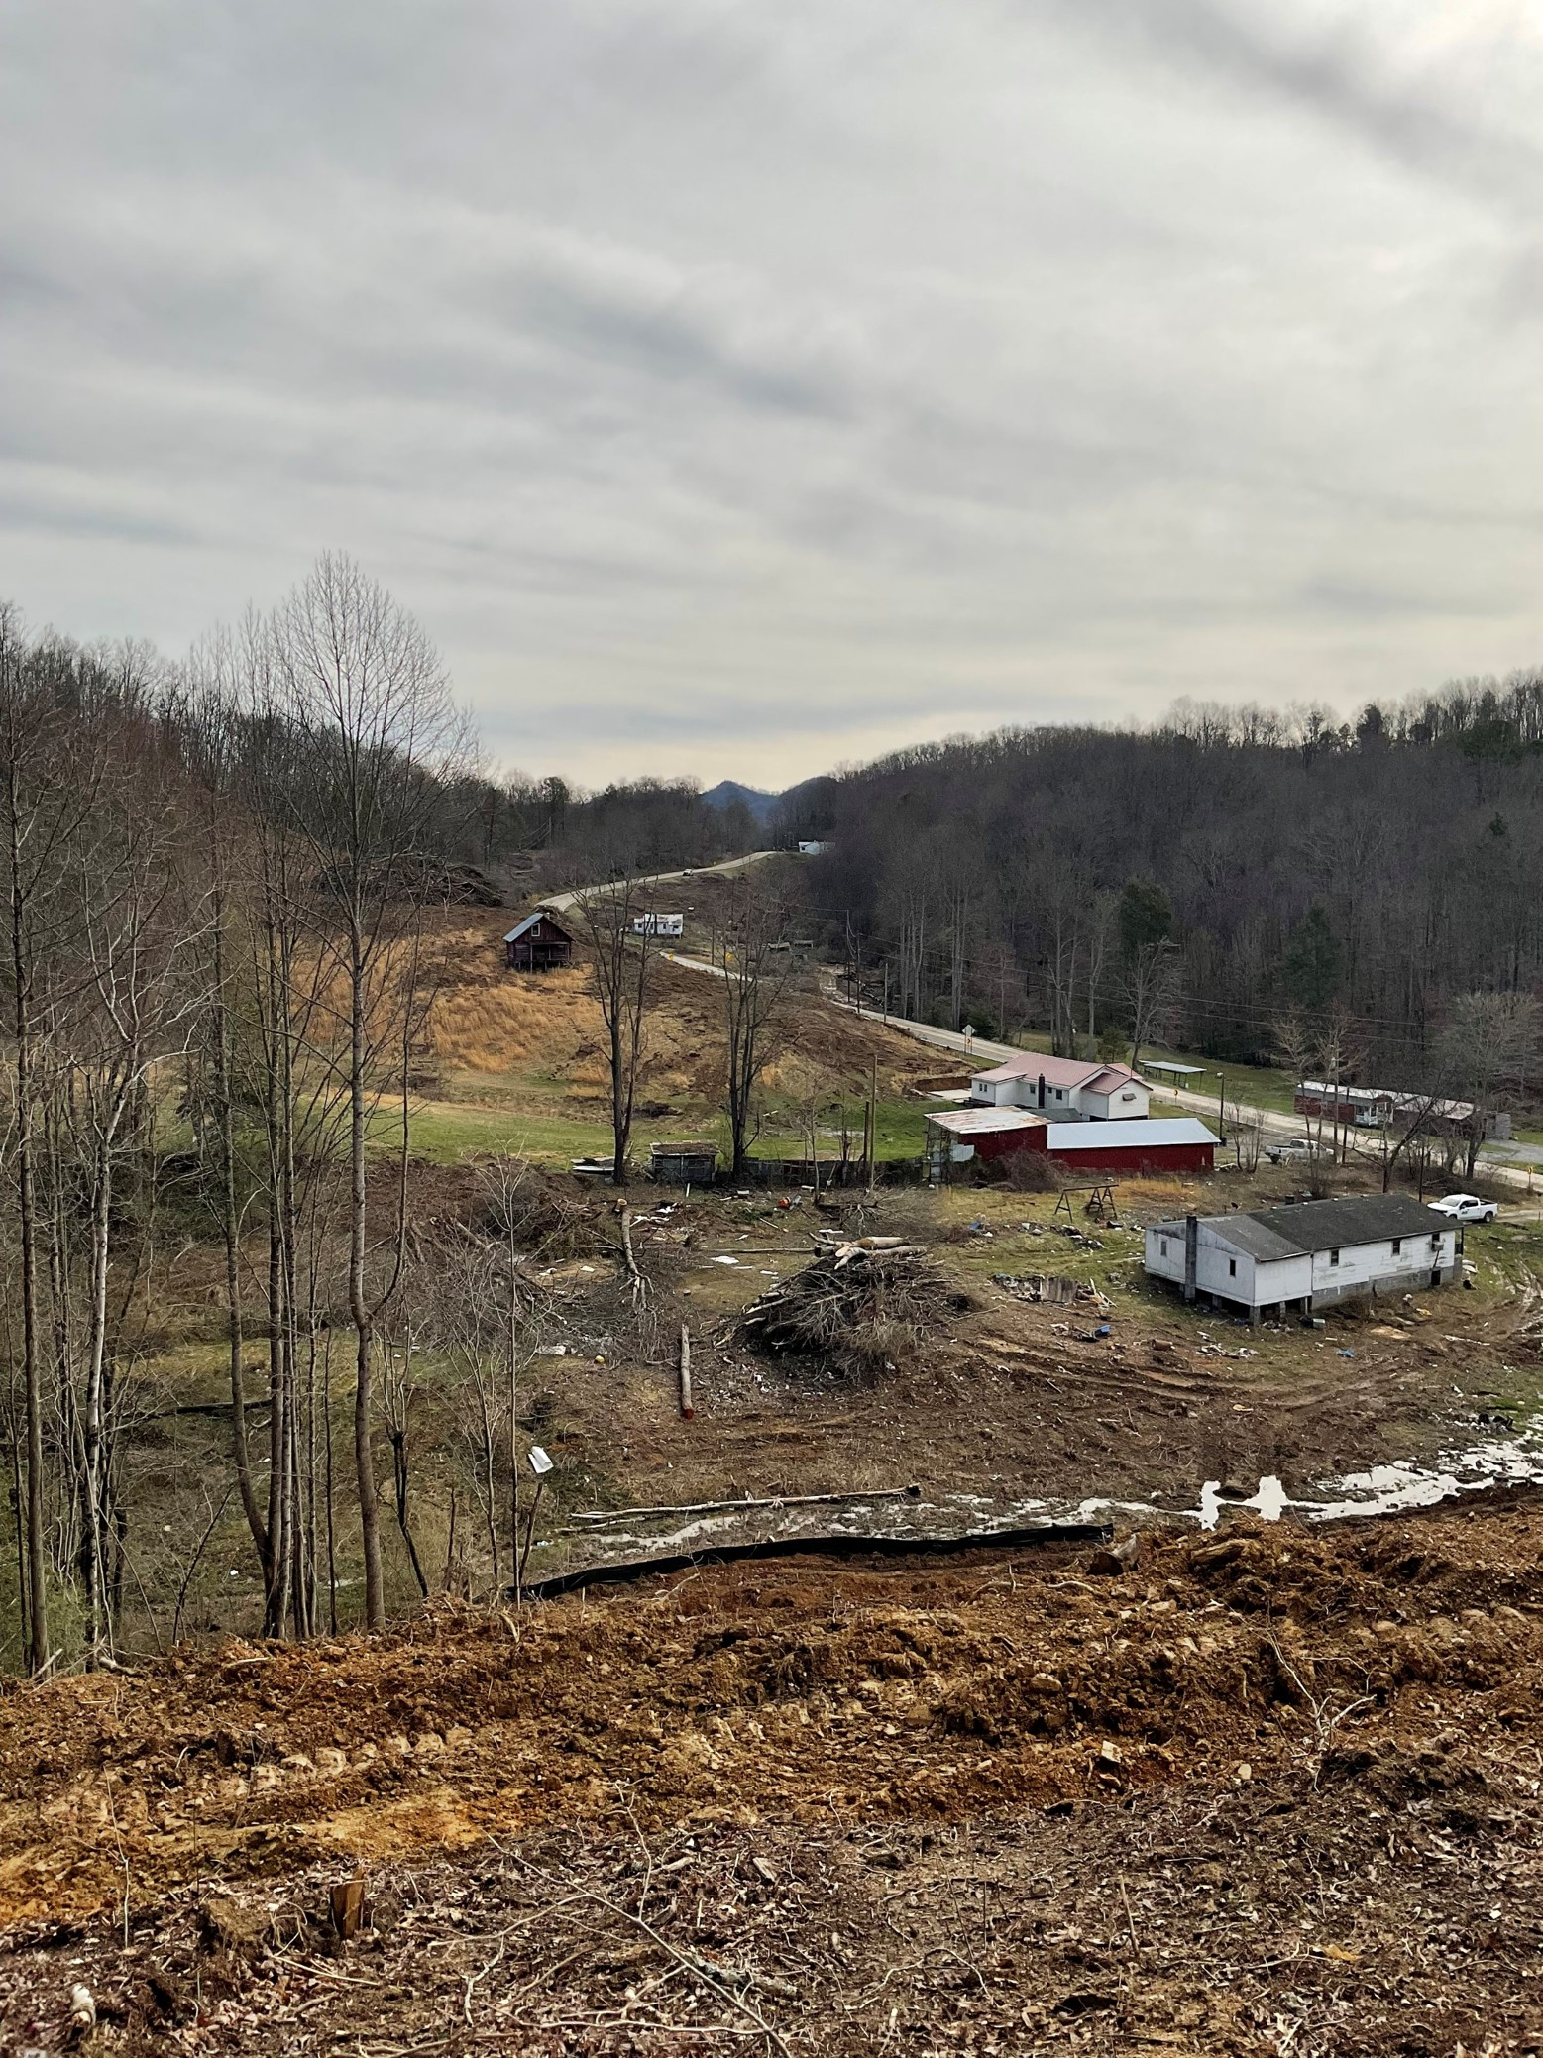
Reinternments cemeteries in both Kentucky and Virginia

Slide 25
So really an
“Impressive Design Build.”
Notes:
May 2023 to Completed Construction 2026

Slide 26


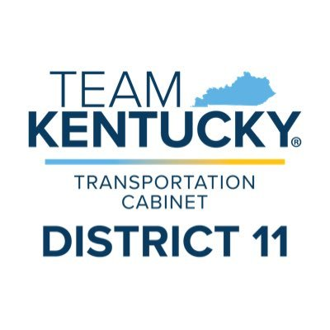



“The People”
Notes:
This project is a testament to the power of collaboration, expertise, and dedication. From its conception in May 2023 to its anticipated opening to traffic in September 2026, the project brought together talented professionals who contributed their unique skills and experience toward a common goal.
The successful delivery of this transformative corridor would not have been possible without the commitment and teamwork of Bizzack Construction, HMB Engineering, the Kentucky Transportation Cabinet, and the dedicated staff of District 11. Through strong partnerships, innovative problem-solving, and a shared vision, this team turned a challenging concept into reality.
The completed project stands as a lasting example of what can be achieved when exceptional people work together with purpose, determination, and a commitment to improving transportation for the communities they serve.

Slide 27
VIDEO FLY THROUGH
(After)

